Slide 1

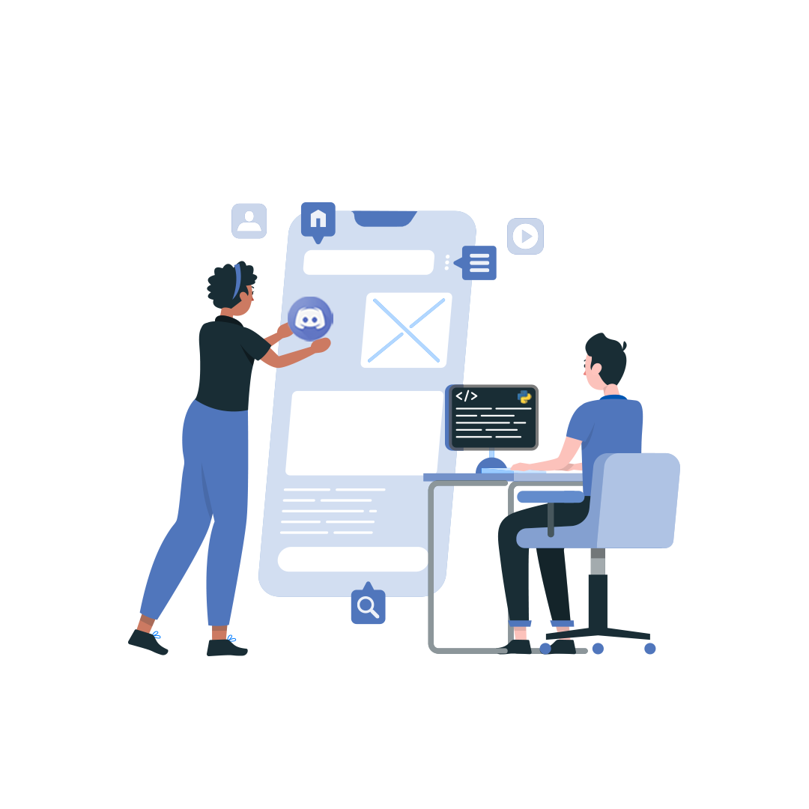
Build-A-Bot
By Adeel Abdul Sakkeer

Slide 2
What we’ll be covering
01
03
02
04
Overview of Discord
Replit
Creating a bot account
Coding the bot

Slide 3
01.
Discord

Slide 4
What is discord?
Discord is a free platform that's used by tens of millions of people ages 13+ to talk and hang out with their communities and friends.
Servers are the spaces on Discord. They are made by specific communities and friend groups.
Channel: Discord servers are organized into text and voice channels, which are usually dedicated to specific topics

Slide 5
02.
Creating a bot
Head over to discord.com/developers

Slide 6
Before getting into the code, we need to create a “Discord application.” This is essentially an application that holds a bot. It can be accessed on discord.com/developers

Slide 7
03.
Repl.it
Repl.it is an online IDE that we’ll be using to host and run the code of our bot.

Slide 8
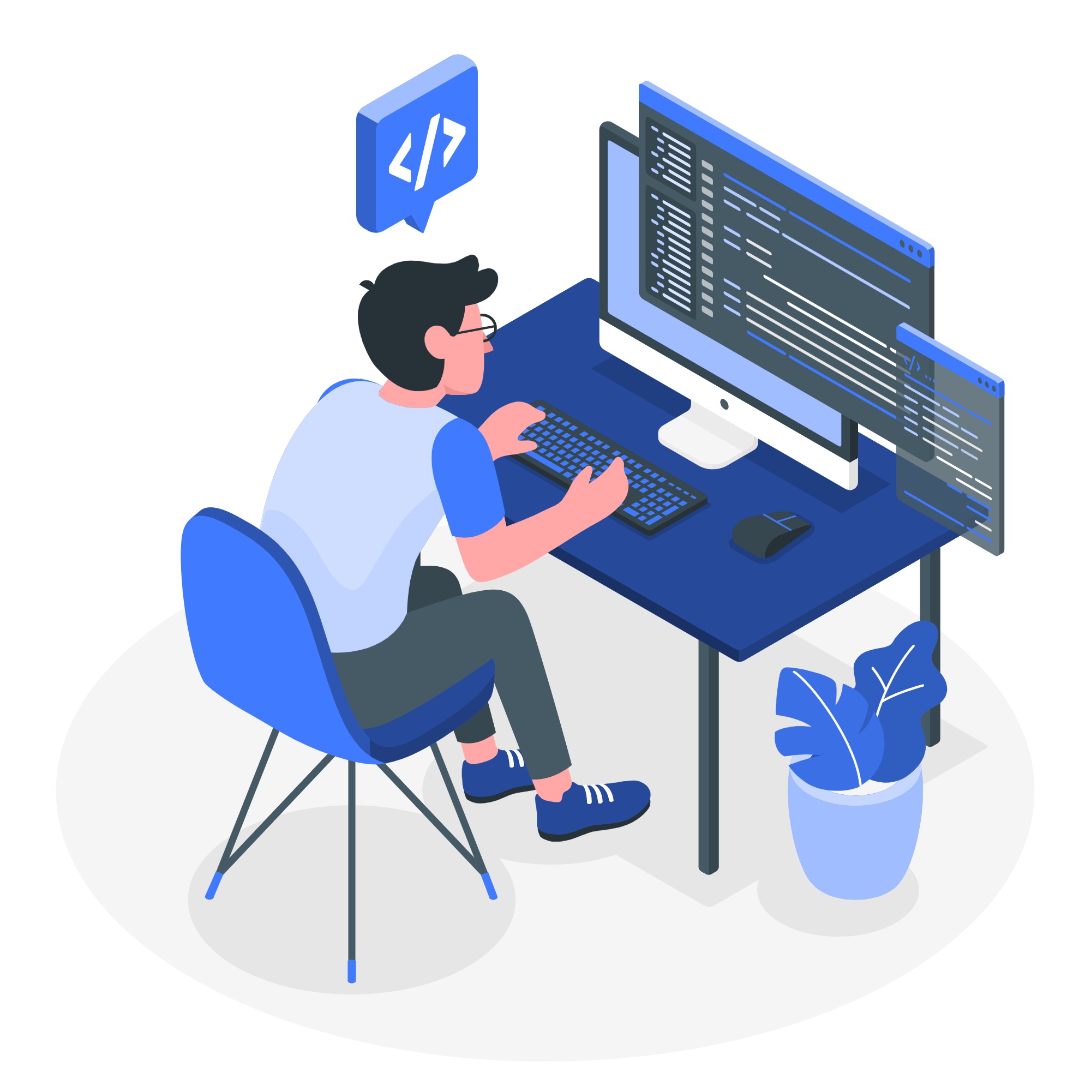
04.
Coding the bot

Slide 9
DISCORD OBJECTS
Common discord object types
To interact with server data discord API provides objects.
Objects have multiple attributes that can be called.
E.G:
An object of type message will have an attribute id which will give the id of that message. It is called by message.id
message.channel returns a object of type channel
message.content will give the text of that message
For an object of type reaction, reaction.emoji will return the emoji used in the reaction
,
Message
User
Channel
Reaction

Slide 10
Detecting a new message
On_message( message ) event will be called every time a message is sent
It contains an object ‘message’ in which the new message will be passed
We will scan the message for keywords or commands e.g: if the message.content startswith so and so then do an action
If the message is sent by the bot itself, then it has to be ignored

Slide 11
Sending messages to a channel
To send a message to a channel we’ll need a discord object of type channel
This is commonly obtained by:
Getting the channel from a message object through message.channel
Fetching the channel by ID from the server
To send to the channel, use channel.send(content)
,

Slide 12
Detecting a reaction
Message cache
on_reaction_add( reaction , user) will be called every time a reaction is added to a message
The user object will contain details of the person who reacted to the message
The reaction object will contain details of the reaction that the user reacted with
On_reaction_add will only detect reactions to messages that are in the message cache
The message cache will contain messages that are sent after the last restart
The cache will be cleared on every restart

Slide 13
Keeping the bot running
Repls go to sleep and stop running after 5 minutes of inactivity
To overcome this we will:
Host the repl on a flask server
Ping the repl using up time bot

Slide 14
What we learnt
01
02
03
Bot application
Repls
Connect to the bot
Creating a discord application and making it a bot
Create a python repl
Use the bot’s token key to connect to the bot via our code
04
05
06
Server Messages
Server Reaction
Host the bot
Detect when a message is sent in the server and work with contents of that message
Detect when a reaction is added to a message and run the code for it
We learnt how to use uptime bot and a flask server to host and keep the bot running

Slide 15
Thank You
Keep up with ISTE
Get in touch with me
Github : ade3l
Github : ISTE-VIT
Instagram : adeel_a_s
Instagram: iste_vit_vellore
LinkedIn : adeel-as
LinkedIn : indian-society-for-technical-education

